Slide 1
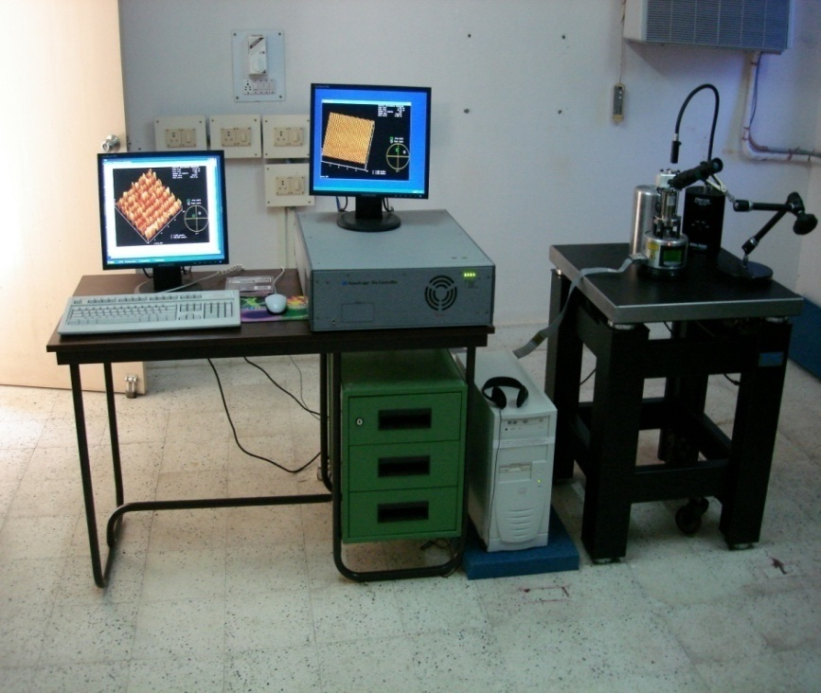
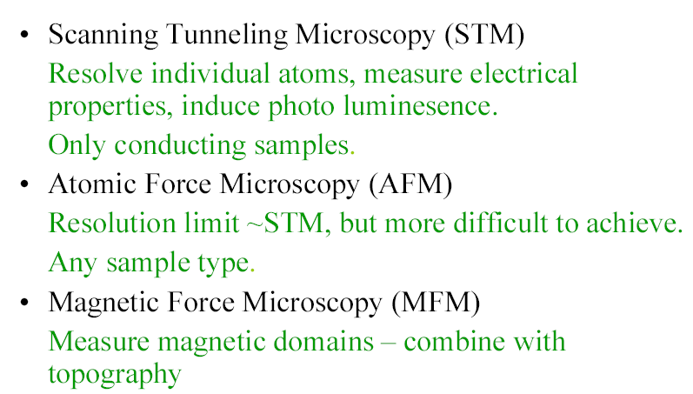
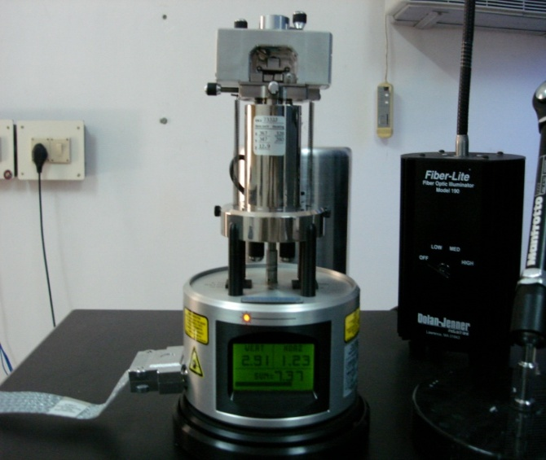
Scanning Probe Microscope Methods

Slide 2
Review of previous classes
1. Nanotechnology in upward motion: next future of science and technology is nanotechnology
2. Constructive - Destructive interference by thin films
3. Non-Reflective Surfaces
4. Super-Hydro-Phobicity
5. Self-Cleaning
Nano in Histroy
The Localized Surface Plasmon Resonance
DICHROISM
Development of nanoscience and technology
Diversity of nano field
Surface to volume atoms of Cuboctahedral system
M(K) = (1/3)*(10K³+15K²+11K+3), K = No. of shell
N_{K} =10K² + 2, Every shell contains number of shell
SIZE EFFECT
Quantum Effect
To-Down Method of Preparation
Ball mill, Thermal, Arc discharge, Laser ablation etc.
LITHOGRAPHIC METHOD
Bottom-UP method
HOW TO REALIZE THE NANOPARTICLE ?
TEM
SEM
SPM

Slide 3
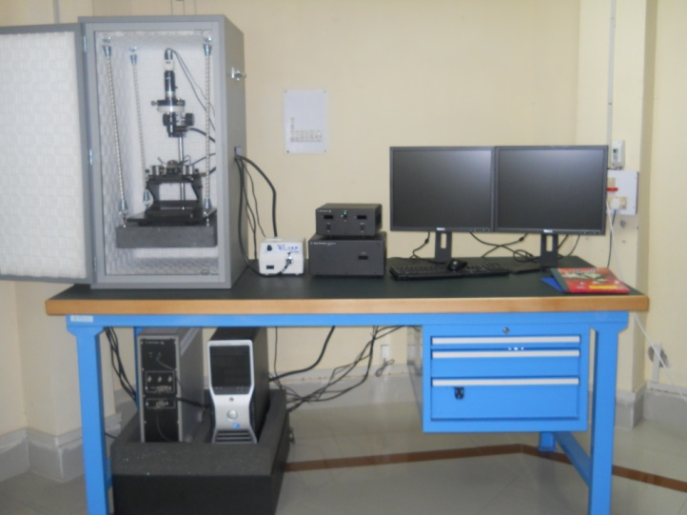

Slide 4
Scanning Probe Microscopy
Scanning probe methods include the following ingredients:
• A sharpened tip attached to a cantilever
• Some kind of applied force
• Physical or electrical cushioning mechanisms
• Scanning (rastering) across a sample surface
• Computerized feedback mechanisms
• Imaging software

Slide 5
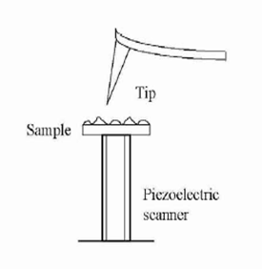
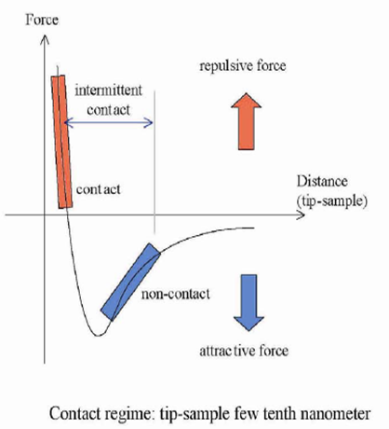
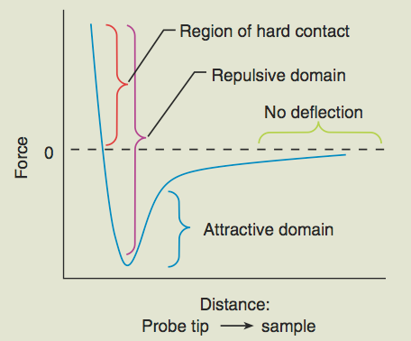

Slide 6
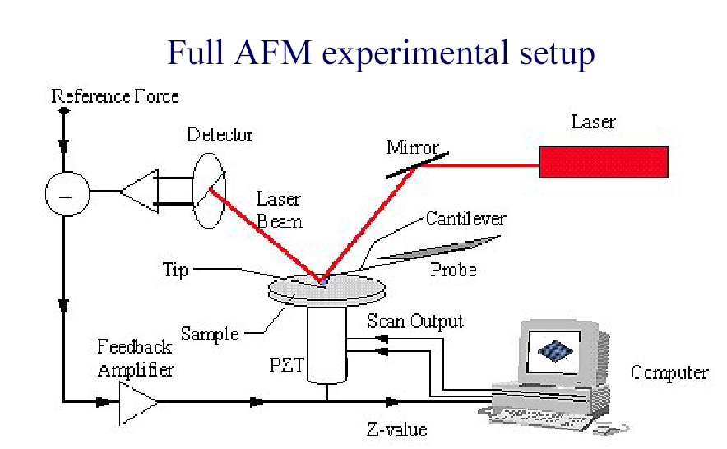
The Force in AFM: F = -kz, k is the spring constant, z is the distance of the deflection of the cantilever
Resolution: Depends upon the radius of curvature of the tip and size of the tip

Slide 7
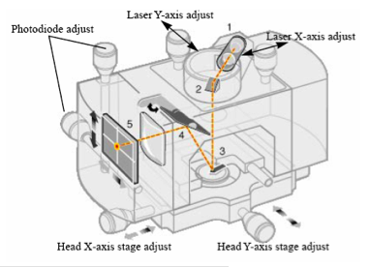
Mode of Operation | Force of Interaction
Contact mode | strong (repulsive) - constant force or constant distance
Non-contact mode | weak (attractive) - vibrating probe
Tapping mode | strong (repulsive) - vibrating probe
Lateral force mode | frictional forces exert a torque on the scanning cantilever

Slide 8
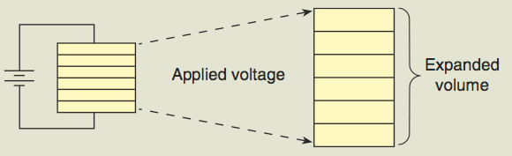
Piezocrystals
Piezoelectricity is the capability to generate electric potentials (electric charges) across the faces of crystals after mechanical stresses have been applied. This is an example of a strain-charge relationship.
Scanners in AFM and STM are based on piezoelectric crystals that expand and contract proportionally to an applied voltage. Precision of movement is extreme in x,y,z directions.
Usually made of zirconium titanate (PZT). +220 V to -220 V ac voltage range is typical.

Slide 9

Laser
Feedback
Electronics
Piezoelectric
Scanner
X, Y
Z
Photodiode
Detector
Cantilever & Tip
Sample
Laser diode reflects light off cantilever and into a two- or four-sector photodiode detector (A+B = total intensity, A-B = up/down motion).
Topography image formed by displaying z-motion feedback voltage necessary to maintain constant tip-sample force.

Slide 10
Types of Scanning Probe Methods
Atomic Force Methods: van der Waals
Lateral Force Microscopy (LFM)
Magnetic Force Microscopy (MFM)
Electric Force Microscopy (EFM)
Scanning Capacitance Microscopy (SCM)
Torsional Resistance Mode (TRmode)
Conductive Atomic Force Microscopy (CAFM)
Scanning Tunneling Methods: tunneling current
Tunneling Atomic Force Microscopy (TUNA)

Slide 11
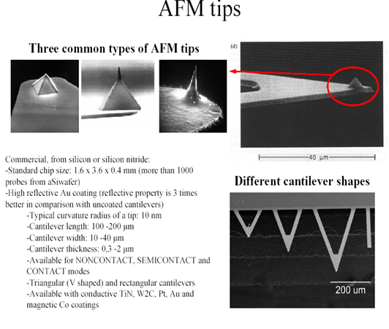

Slide 12
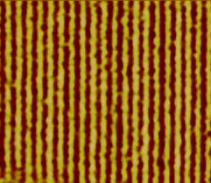
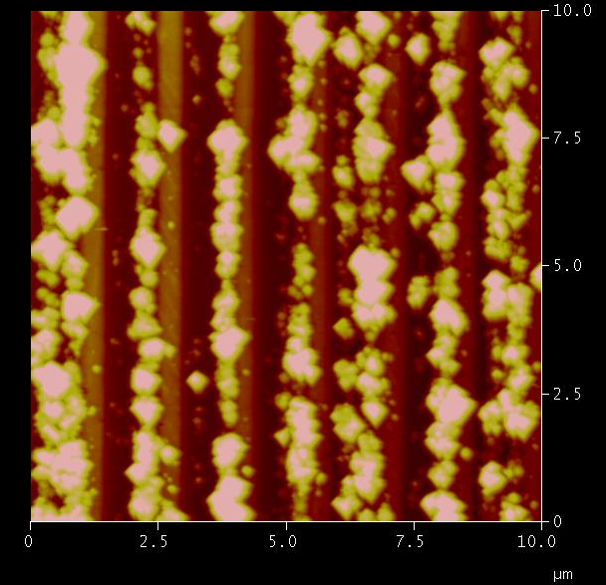
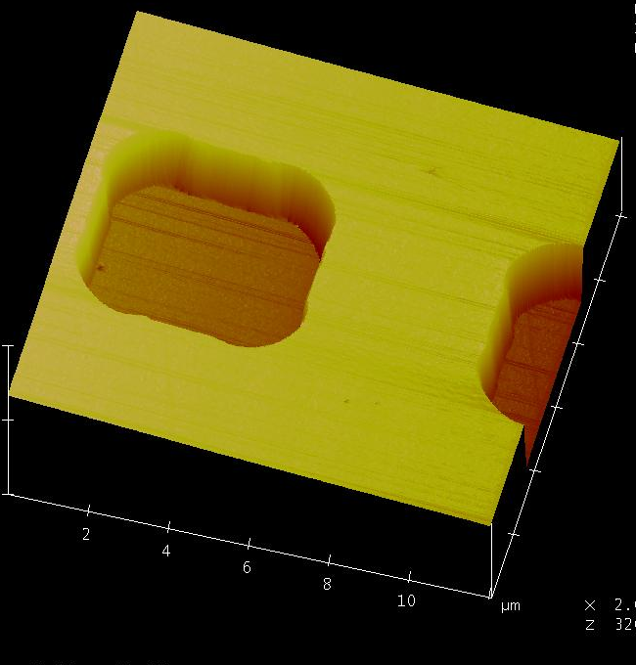
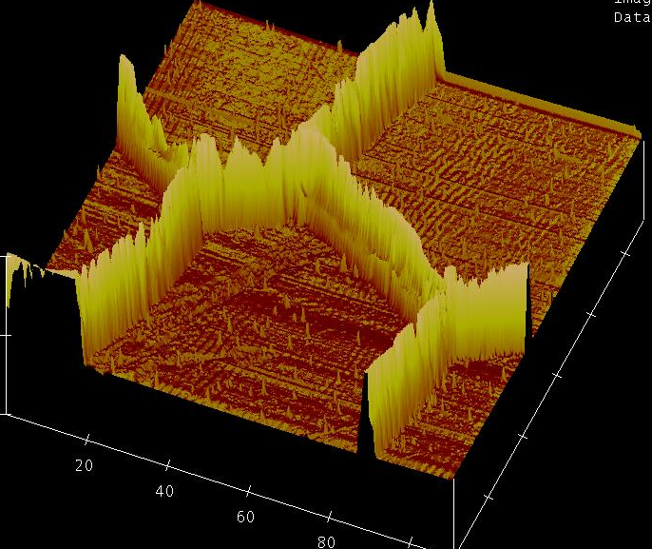
AFM Result
CD with Nanoparticles
CD
TEM Grid
TEM Grid

Slide 13
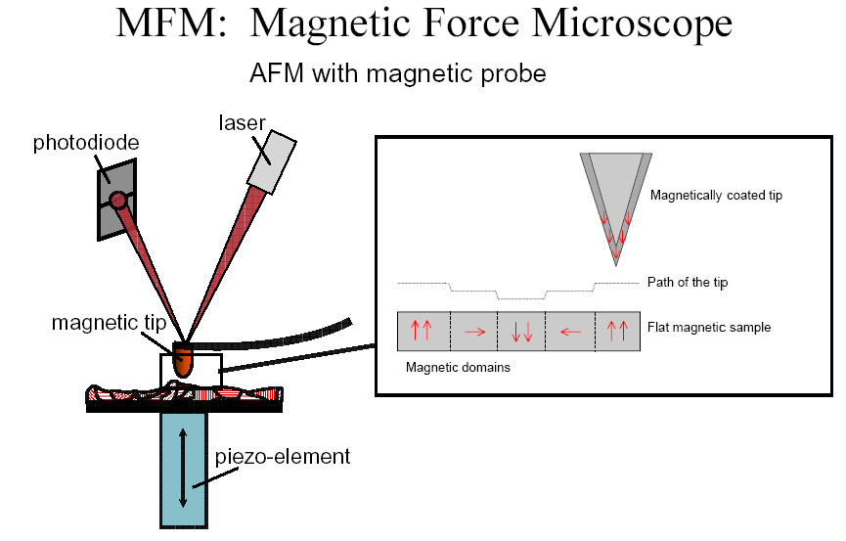

Slide 14
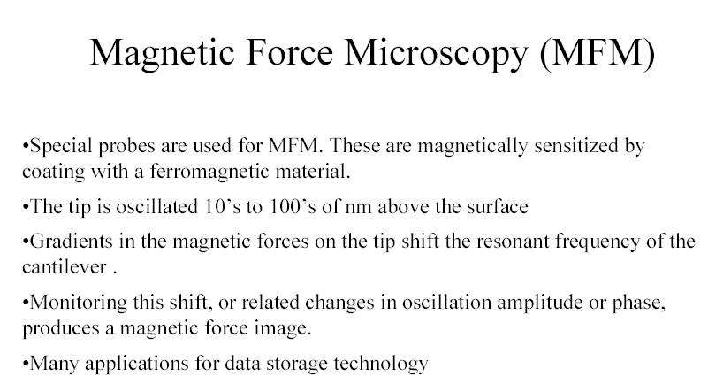

Slide 15
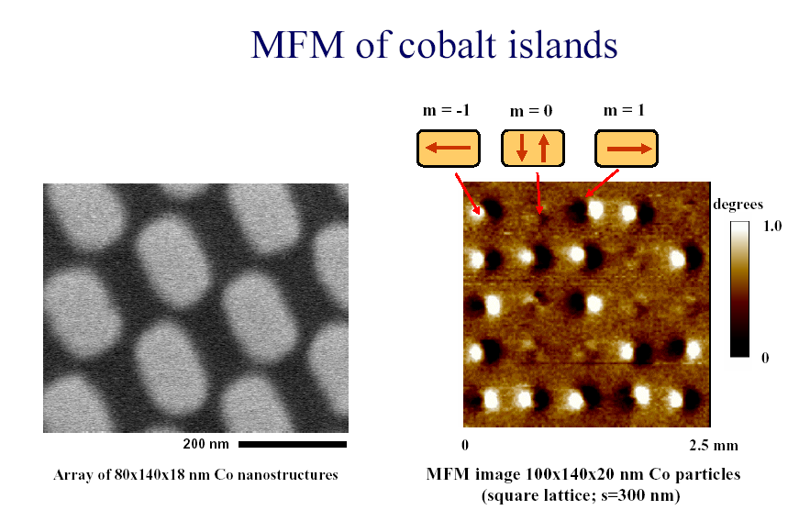

Slide 16
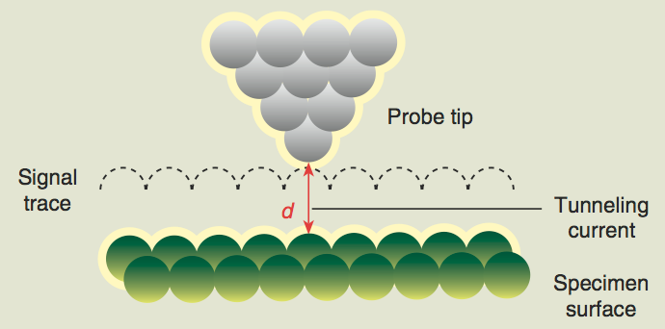
Scanning Tunneling Microscopy

Slide 17
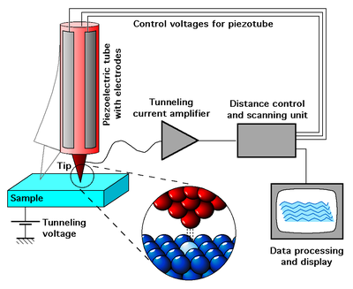
Basic principle is tunneling.
Tunneling current flows between tip and sample when separated by less than 100nm.
The tunneling current gives us atomic information about the surface as the tip scans.

Slide 18
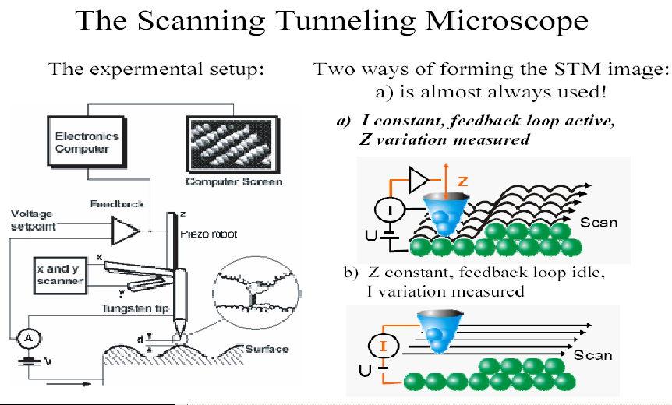
constant tunneling current mode
Constant height mode (tip at fixed height, current change measured)
Metals: High density of states at atoms: Atoms appear as bright protrusions
Insulators: No conduction possible-> we crash
Semiconductor and thin oxides: Complex electronic structure at fermi level: be careful

Slide 19
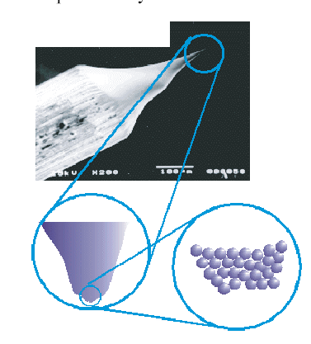

Slide 20
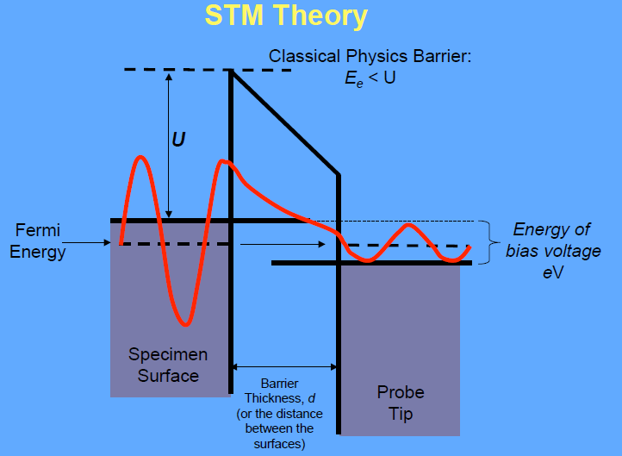

Slide 21
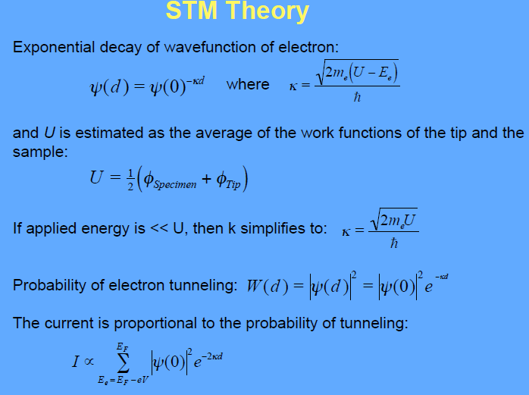
e
2

Slide 22
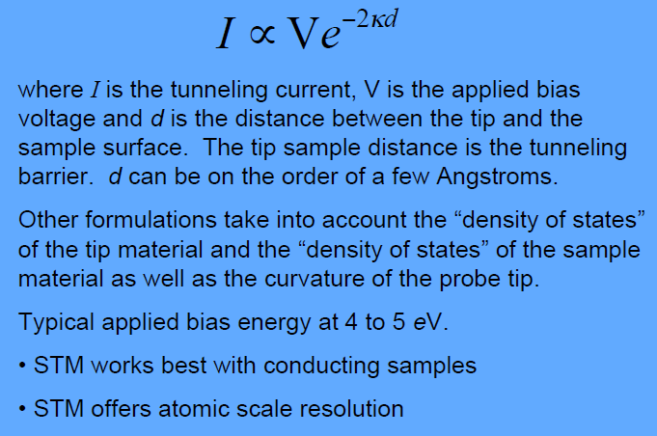

Slide 23
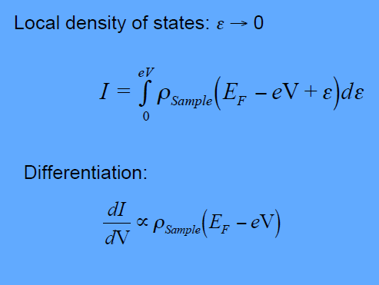

Slide 24
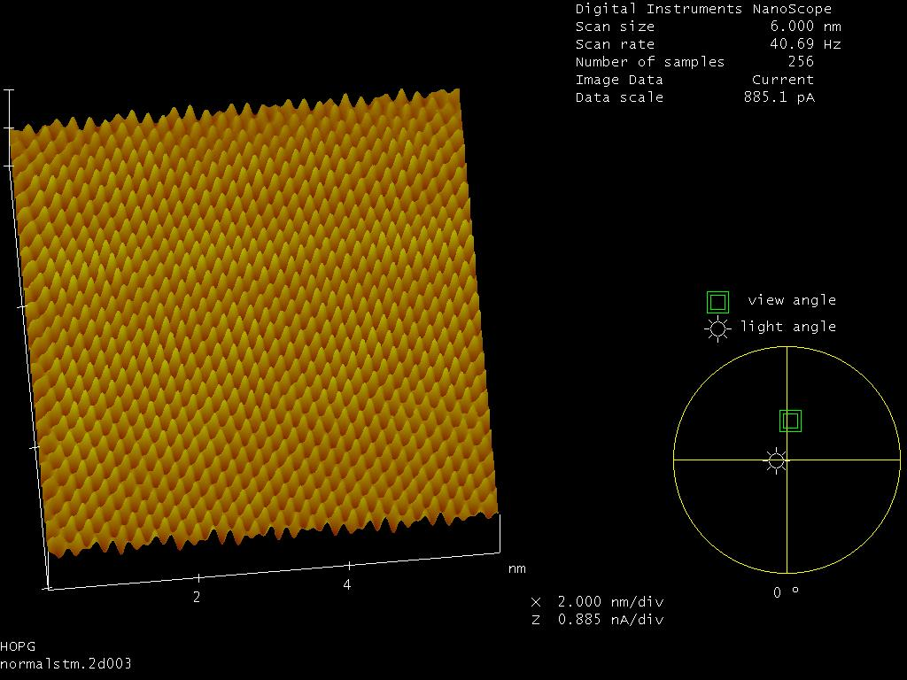
STM Micrograph for Graphite

Slide 25
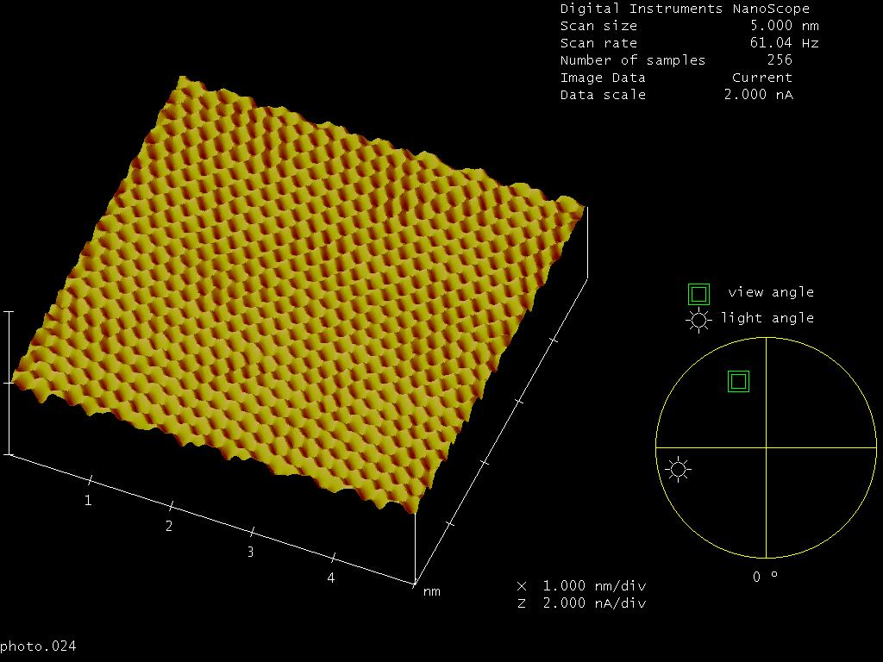
STM Micrograph for Graphite

Slide 26
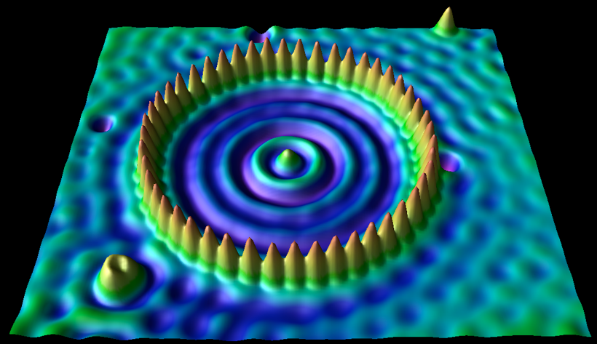
Quantum (confined) corral
Standing wave patterns on a Cu(111) surface caused by quantum mechanical interference patterns formed from the interaction between Fe atoms and the surface plasmon of copper.

